Slide 1
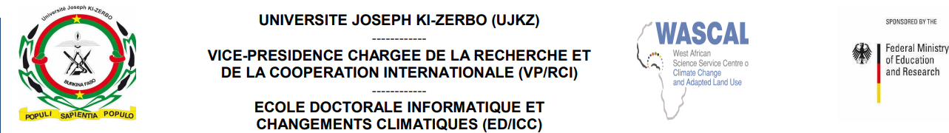
Assessment of Consecutive Dry Days (CDD) in West Africa: Model Evaluation and Climate Projections
Presented by
Abdoulaye DIOP
Supervised by
Dr. Windmanagda Sawadogo
23/09/2024

Slide 2
Outline
Introduction
Background of the Study
Study area
Objectives
Data descriptions
Methodology
Results and discussions
Conclusion
References

Slide 3
Introduction
Consecutive Dry Days (CDD) are periods where rainfall is less than 1 mm for consecutive days, often used as an indicator to assess drought conditions. CDDs play a crucial role in understanding water scarcity, agricultural stress, and ecosystem vulnerability. Globally, regions prone to dry spells are seeing an increase in the duration and frequency of these events due to climate change.

Slide 4
Background of the study
CDDs pose a serious challenge due to the region's dependence on rain-fed agriculture. Increasing frequencies of dry spells lead to reduced crop yields and heightened food insecurity. Many areas currently experience over 100 consecutive dry days annually, and climate change is projected to worsen this situation. This study aims to analyse CDD trends and provide insights for effective management strategies.

Slide 5
Study area
The study focuses on West Africa, which is characterized by its semi-arid climate and vulnerability to drought. The area’s reliance on seasonal rainfall makes it critical to understand CDD dynamics and their implications for local communities

Slide 6
Objectives
To assess the performance of different climate models (ACCESS, MIROC, and NorESM2-MM) in simulating historical CDD trends in West Africa.
To project future CDD patterns under various climate scenarios (SSP126, SSP245, SSP585) for near-term (2021-2050) and far-term (2071-2100) periods.
To analyse trends and anomalies in CDD by comparing historical data with future projections

Slide 7
Data descriptions
The analysis utilizes data from CHIRPS (Climate Hazards Group InfraRed Precipitation with Station data) for historical CDD assessments and various climate models, including ACCESS-CM2, MIROC6, MPI-ESM1-2-HR, NorESM2-MM, MRI-ESM2-0, NESM3, and TaiESM1 for future projections.

Slide 8
Methodology
We used the eca_cdd,1 command from Climate Data Operators (CDO) to calculate the Consecutive Dry Days (CDD) index.
It will generates two indices (CONSECUTIVE_DRY_DAYS_INDEX_PER_TIME_PERIOD and NUMBER_OF_CDD_PERIODS_WITH_MORE_THAN_5DAYS_PER_TIME_PERIOD ) but we will focus on one:
Consecutive Dry Days Index per Time Period: The maximum number of consecutive dry days each year from 1985 to 2014 (historical) and projections for 2030-2061 (near future) and 2071-2100 (far future).

Slide 9
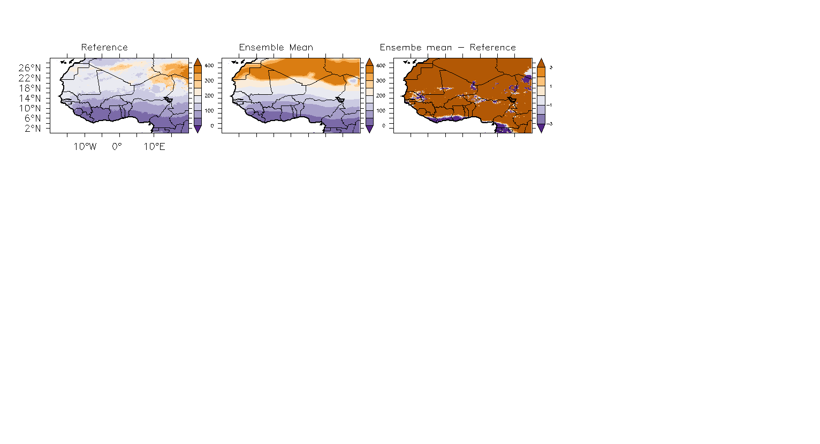
Model Evaluation
Bias = Ensemble Mean - Reference

Slide 10
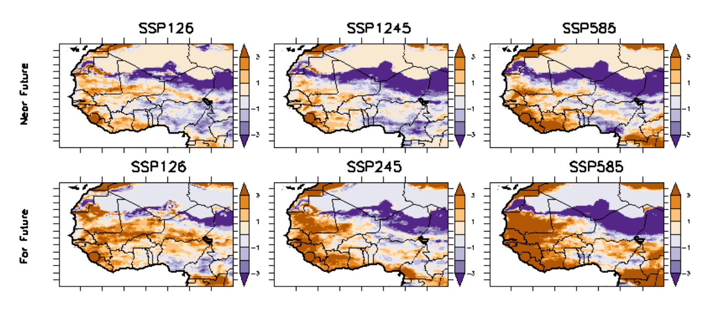
Model Projection

Slide 11
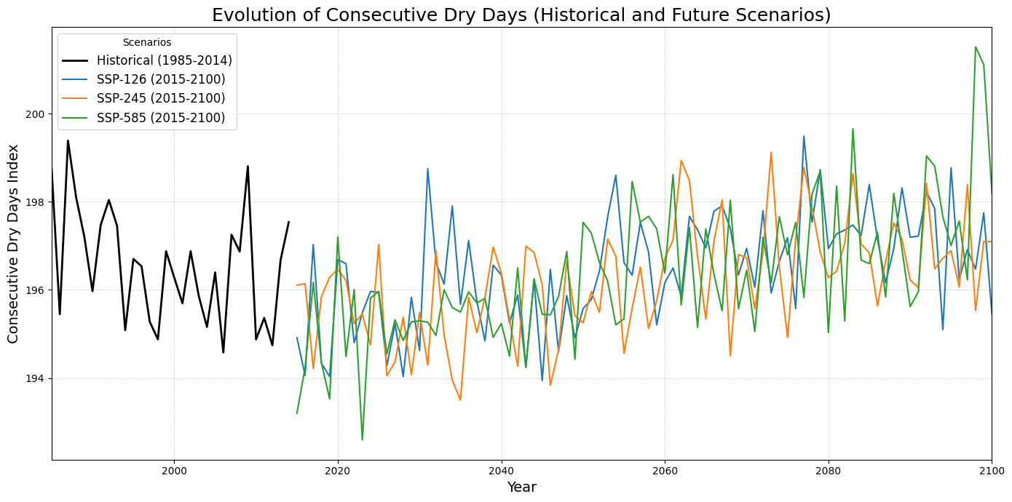
Evolution of Consecutives dry day

Slide 12
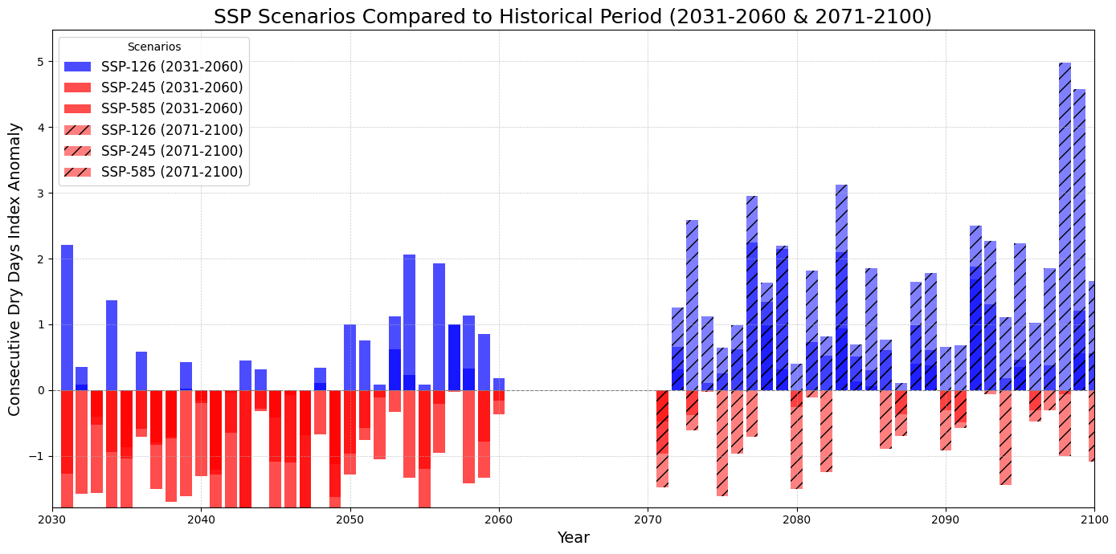
Consecutives dry day index anomaly

Slide 13
Conclusion
Understanding CDD patterns is crucial for developing effective agricultural and water management strategies in West Africa. Findings will inform policymakers about risks and necessary adaptations to mitigate impacts from increasing dry spells.

Slide 14
References
Iles, C., Sandstad, M., & Schwingshackl, C. (2022). Climate extreme indices from CMIP6 projections. Copernicus Climate Change Service. DOI: 10.24381/cds.776e08bd.
Abiodun, B.J., et al. (2018). Impact of 1.5°C and 2°C warming on consecutive dry and wet days in West Africa. Environ. Res. Lett., 13, 055013.
ATLAS (2018). West Africa Climate Risk Profile. USAID. Retrieved from [link].

